Slide 1
APEX Essentials Architecture and user flow
Keshav Polepalle

Slide 2

Agenda
User Personas
Usage Pattern
Proposed Solution:
Architecture
Design considerations
Assumptions/ Risks
Project Plan
User Flow
Scope Review

Slide 3
User Personas

Slide 4
User Personas
User Type | Details
Standard User/ Admin User | View reports for specific accounts
Power User (RE) | View reports for specific account Create and deploy reports for specific account (Custom reports)
Super User | View, Create and deploy the below: Standard reports to all accounts Premium reports to Premium accounts (Not a part of current phase)

Slide 5
Usage Pattern
Type | # of accounts and users (estimates)
Reports | Standard: 25 Premium: On need basis Custom: On need basis Hidden: Maintained by Juniper Admins
Accounts | 500
Internal Users | 1500
External Users | 2500
Total Users | 4000
Demographics | Details
User Distribution | AMER: 40% EMEA: 40% APAC: 20%
Usage Pattern | Infrequent users: 50% (connect once every quarter) Regular users 50% (connect daily)

Slide 6
Proposed Solution

Slide 7





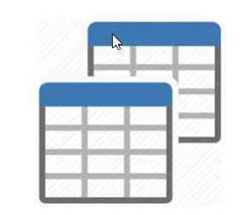


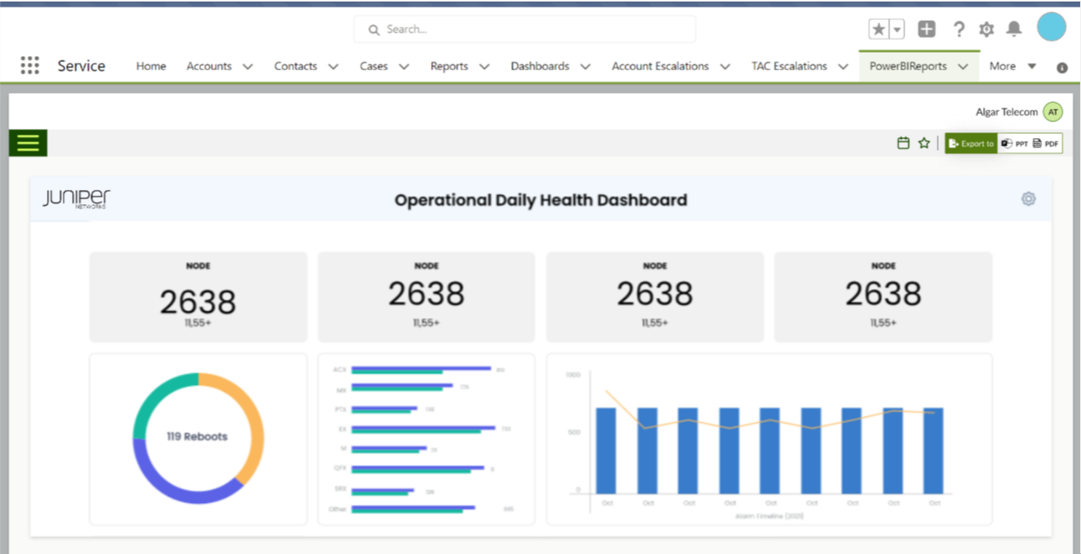

Overall Components
1
2
3
Power BI
Send emails
Trigger API endpoint on new view creation
SFDC
Account_10011
Account_10021
Account_20011
Access notification emails
Export reports as PDF/PPTX
Web API
Custom Report
Web Job
Trigger pipeline with Account ID
Create & Publish the report files to the workspace
4
SFDC
Premium Reports
Premium Reports
Custom Report
Config Tables (Salesforce Objects)
Users
GitHub
Pipelines
Set notification schedule for the embed report
Std Reports
Std Reports
Std Reports
Reports shown based on accounts & roles
Power BI Secure Embed
Login to portal
Power User
Publish custom report for an account
Snowflake
Snowflake
Snowflake
Reports connected to account specific materialized views
Azure Alerts
1
Customer Provisioning
2
Power BI Reports
3
Report Notifications
4
Embedded Analytics in Salesforce

Slide 8
Capacity requirements
Type | Details
No of accounts (current user base) | 25
No of report refreshes | Average 1/ day Average refresh time for 1 dataset: 20 mins
Average Dataset size | 250 MB/ dataset
Recommendation:
Power BI dataset for each account will be an Import model considering average data model size of 250 MB. To fulfil this requirement, we will need embedded capacity. We can use Power BI Embedded A5 capacity
Scaling required for the capacity will be tracked through ‘Power BI Capacity Metrics App’

Slide 9
Embedded Analytics in Salesforce

Slide 10
Business Requirements
High Level:
Create embedded data visualization solution by migrating and enhancing existing Tableau solution to Power BI reports that can be consumed individually by customers through SFDC portal
Detailed:
Create a Salesforce embedding component which shows a Power BI report based on the account id passed to it
The component should be able to show the following types of reports:
Standard reports: Available to all accounts
Custom reports created by Power User (Juniper internal): Available to specific accounts for which the report has been created
Ability to deploy new standard reports/enhancements to existing standard reports available to all accounts
Ability to extract visual level data in Excel, CSV
Ability to export report (single page) data in PDF, PPTX
Ability to mark a report as favorite for easy access

Slide 11




Salesforce Embedded Portal: Architecture
Owned by Juniper
SFDC
1
Login to portal
Apex Controller Class
Helper function
(Accounts associated with User)
Accounts Dropdown
User lands on SFDC portal and defaults to an Account
5b
Users
3
5a
Account validation
Workspace Id
App ID & Secret
AAD Service principal
4
Get report config details by Account & Role
Get App Only Access Token from AAD
2
Custom Metadata Type for App id and secret(Salesforce Objects)
Report Config (Salesforce Objects)
6
Access Token
SFDC Embedded Widget
(Lightening Web Component)
8
7
Embed URL and Embed Token passed
9
Power BI API
Generate Embed token for report rendering
10
Logging usage metrics in Application insights

Slide 12
Salesforce Embedded Portal: Assumptions/ Risks
Assumptions:
Reports will be shown based on the account mapping and role
We will show Landing Page report on the ‘Dashboard’ tab as the default page. The default report will be for the account passed from SFDC. User can then select any other page from the dropdown
Standard message will be displayed in case no account ID is passed to embedded component
SFDC will expose function for account validation (checking the user access on the account)
Data extract at visual level will support OOB Excel and CSV format
Data extract at report level will support PPTX and PDF using OOB Power BI APIs
Data retention for usage report is 3 months
Static link to Juniper Support Portal will be added to the SFDC Widget
Static link to Knowledge Base will be added to the EOL/EOS report
From a testing standpoint, we will be verifying on these resolutions: 1024x768 and 1920x1080
Risks:
Power BI reports are being developed using the Dev database, instead of Production database

Slide 13
Report Notifications

Slide 14
Business Requirements
High Level:
Create ability to schedule reports and data downloads along with supporting notification mechanisms
Detailed:
Ability to set report export (PPTX/PDF) format from Salesforce embedded widget
Ability to edit/ delete the created schedules from Salesforce embedded widget
Notifications will be sent as per the frequency set while creating the schedule

Slide 15





Report Notification Scheduler: Architecture
SFDC
Azure
Set notification schedule for the embed report
Key Vault
Fetch certificate for secure connect to Salesforce
1
13
Fetch certificate for secure connect to Salesforce
15
Send notification to Juniper Admin
3
4
Users
Get the schedules to be set from
Salesforce Objects via “connected app”
7
2
Check on Queue size
(Task Consumer)
Service Bus trigger function
11
Send emails with the required details
6
Save schedule config in Salesforce Objects
Web Job
5
Service Bus
Azure Function
Success/ Failure status
(Task Producer)
Add messages to Queue
12
Config Tables (Salesforce Objects)
Application Insights
14
Save log details
Access link is generated and returned
8
Rest API for exporting reports
9
10
PDF/PPT exports are stored in OneDrive
Power BI API

Slide 16




Report Notification Scheduler: Orchestration
Owned by Juniper
Owned by MAQ
Snowflake
SFDC
Notification Scheduler
Junos Devices
1
2
New Collection
(2 AM Local Time)
Notification of new collection completed
3
JSAS/LWC
Backend
API Gateway
NFX
VM
4
5
Refresh Power BI Datasets
Trigger notifications

Slide 17
Cost estimate
Type | Region | Details | Estimated Monthly Cost
App Service | West US 2 | Standard Tier; 1 S1 (1 Core(s), 1.75 GB RAM, 50 GB Storage | ~$75 - $100
Service Bus | West US 2 | Standard tier (Message operations less than 1 million) | ~$10 - $20
 |  | Total | ~$85 - $120

Slide 18
Report Notification Scheduler: Design considerations
Notification scheduler will export the reports as PDF/PPTX document
Entire report will be exported (Considering current standard reports as a single page)
No of notifications sent/ minute will be limited based on the Power BI capacity availability
Exported reports cannot exceed a file size of 20 MB
Report export will contain the visualizations based on the default filters applied on report

Slide 19
Report Notification Scheduler: Assumptions
Notification is sent to the user requesting for export
PPT and PDF exports of reports will be supported. Excel export is only supported for On-Demand exports through Power BI OOB feature
User can set the frequency (Daily/ Weekly/ Monthly) of the schedule. The minimum notification can be set at a day level.
Notifications will be triggered through the API endpoint exposed to Juniper team
External users will have access on OneDrive for accessing the report export links
Notification logs will be captured in the Application Insights
Sending scheduled notifications as FTP/SharePoint/Google Docs (not in current phase)

Slide 20
Customer Provisioning

Slide 21
Business Requirements
High-Level:
Develop a custom API to provision new Power BI workspace for Automated report template and report deployment for customers and end users
Detailed:
All the reports (standard/ premium) applicable to the account are deployed to account-specific Power BI workspace
Super User should be able to create and deploy reports for all the accounts
Power User should be able to create and deploy custom reports for specific account to which they have access
New reports/ enhancement to existing reports (standard/ premium) should be deployed for all the applicable accounts
Reports will be deployed as templatized reports and Super User has the capability to enable/ disable reports using a Power Apps interface.

Slide 22

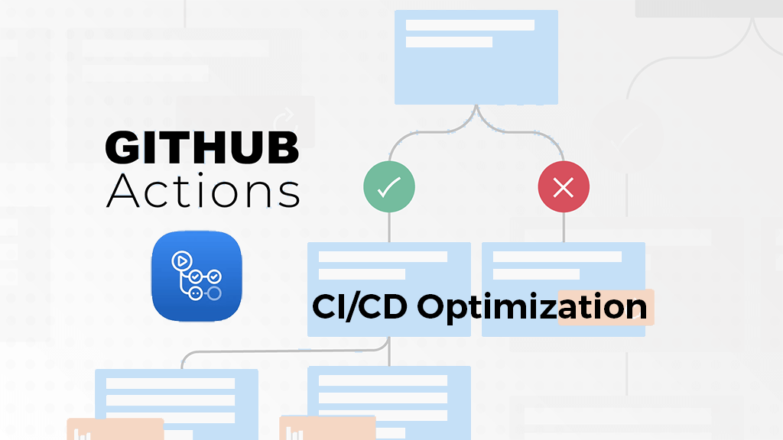
Customer Provisioning Pipeline (New Customer)
Owned by Juniper
Owned by MAQ
Snowflake
Azure
GitHub Release pipeline
Power BI Workspace
7
Perform operations for Power BI Workspace
Get the Power BI reports from GitHub repository
Std Reports
AAD Service principal
3.b
8
Push the reports from Git to the workspace
Premium Reports
5
Fetch Service principal for Power BI workspace access
Update the dataset parameters
(Snowflake views)
9
New Account is provisioned at Snowflake
2
Invoke GitHub release pipeline with Account ID as parameter
10
Prod Report – Account_20011
Get the Workspace and Report IDs
Invoke authenticated custom API from SFDC
Fetch certificate for
Secure access to Salesforce
Web API endpoint
(Deployed in WEST US region)
GitHub
Release Pipeline
1
11
4
Access Salesforce objects via connected Apps
SFDC
Store the Account and workspace mapping in Config tables (Salesforce objects)
Use the Snowflake view name based on Account ID parameter
12
3.a
On Success/failure, Send notification to Juniper Admin
Permissions table
(Stores mapping of users and account for access management)
Key Vault
6
(1): SFDC team needs to invoke API endpoint with Account ID(s)
(6): Fetch the users and associated accounts from Salesforce Permissions table (maintained by Juniper)
(7): Operations performed here:
Create workspace based on Account ID
Assign Embedded capacity
Add user permissions based on mapping
Separate flow will also be created to refresh these periodically
Note:
Retry scenarios will be incorporated in implementation. For failures, we will re-deploy the last build

Slide 23
Customer Provisioning Pipeline (Incremental Changes)
Owned by Juniper
Owned by MAQ
Juniper Users
GitHub Release pipeline
Worker tasks
Power BI Workspace
Get the updated reports from GitHub repository
7
Use the Snowflake view name based on Account ID parameter
Std Reports
Key Vault
Premium Reports
4
3
Super Users/Developers
8
Custom Reports
6
Push the reports from Git to the workspace
Users make changes to report (std, premium) and push to GitHub
2
Call the Worker tasks in loop for each account
Trigger the GitHub release pipeline as per branch policy
9
Notify the pipeline on loop completion
Update the dataset parameters
(Snowflake views)
Prod Report – Account_20011
GitHub
Release Pipeline
GitHub
Release Pipeline
1
11
5
10
Maintain execution logs in SFDC Objects
SFDC
Prod Report – Account_20021
Fetch Account and workspace mapping from Salesforce via connected apps
Config Tables
Log tables
Prod Report – Account_20031
Send a consolidated pipeline run status to Juniper Admins
(1): Super Users/ developers make changes to Power BI reports and deploy the reports to Git
(4): Fetch certificate for secure access to Salesforce
Note:
Retry scenarios will be incorporated in implementation. For failures, we will re-deploy the last build
12

Slide 24
Customer Provisioning Pipeline: Design considerations
All the deployments would be done using Service Principal account
Considering the user growth, we can distribute the load across multiple embedded capacities as the system scales

Slide 25
Customer Provisioning Pipeline (Assumptions/ Risks)
Assumptions:
Updating the standard reports will require re-deployment of all the reports for each account
Every new account will have corresponding Snowflake view created before the account is provisioned
SFDC team will use the API endpoint for customer provisioning. This API can be included as an additional step in view creation pipeline by Juniper team
Standard, Premium and Hidden reports will be deployed using GitHub pipelines
Power user will be responsible for back-up and version control of custom reports
Snowflake view name format is standardized and based on the account ID
Schema of the Snowflake view for each account is consistent
Connecting to multiple data sources is allowed in Power BI datasets. This is not applicable to Power BI reports (live connected)
SFDC will provide the user and role mapping. This will used to control access on Power BI Workspaces
Enterprise GitHub account will be provisioned
Risks:
POCs performed for customer provisioning is not tested on Juniper environment.

Slide 26
Overall Solution: Deliverables
# | Feature | Due Date
Milestone 1 | Prepare the detailed project execution plan Receive sign-off on the below items: Completed Solution Architecture Mock-ups and user flows for the below: Salesforce Embedded Widget Power BI Report theme Finalize the Power BI data model for migration | 1/14
Milestone 2 | Complete developing the Power BI reports for below Tableau reports: Launch Pad Std Report 01: Landing Page – summary Operational Daily Health Dashboard Std Report 20: Physical Interface Std Report 10: Hardware Inventory Std Report 30: Alarm Details Std Report 81: Commit History Complete the below items: Salesforce Embedded Widget (without Scheduler Utility) with the above reports GitHub pipeline for provisioning new customer | 2/15

Slide 27
Overall Solution: Deliverables
# | Feature | Due Date
Milestone 3 | Complete developing the Power BI reports for below Tableau reports: Std Report 11: Search Hardware Std Report 12: Compare Hardware Std Report 90: Systems Report Std Report 21: Logical Interfaces Std Report 70: Hardware EOL/EOS Status Std Report 82: Routing Engine Health Std Report 80: Device Management Inventory Std Report 91: Serial Number Exception Complete the below items: Scheduler Utility for sending notifications to external/ internal users GitHub pipeline for deploying the incremental changes | 3/22
Production Release 1 | Salesforce Embedded Widget Customer reports: 14 std reports Customer Provisioning Pipeline Scheduler Utility | 4/12

Slide 28
Overall Solution: Deliverables
# | Feature | Due Date
Milestone 4 | Complete developing the Power BI reports for below Tableau reports: Std Report 45: OSPF Std Report 50: BGP Std Report 40: IS-IS Std Report 60: RSVP Std Report 83: Coredumps Other reports: Usage and Adoption reports Complete the below helper utilities: Updating the permissions to Power BI workspace | 5/4
Milestone 5 | Incorporate the UAT feedback | 5/17
Production Release 2 | Coordinate production deployment through existing CI/CD pipeline Documentation or walk-through recordings for deployed solution and TOI (Transfer of information) provided to Juniper | 5/31

Slide 29





Overall Solution: Timeline
M1
M2
M3
M4
M5
Detailed Project Plan
Solution Architecture
Report mock-ups, SFDC Widget mock-ups
Power BI Model
Database schema
6 Std Reports
Customer Provisioning (new customer)
Salesforce Embedded Widget
8 Std reports
Scheduler Utility
Customer Provisioning (incremental changes)
5 Std Reports
Usage Report
Adoption Report
Other utilities
UAT
KT sessions
Hand-off
Release stabilization
Push to Prod
Push to Prod
Nov 18
----------
Dec 31
Jan 7
Jan 14
Jan 21
Jan 28
Feb 4
Feb 11
Feb 18
Feb 25
Mar 4
Mar 11
Mar 18
Mar 25
Apr 1
Apr 8
Apr 15
Apr 22
Apr 29
May 6
May 17
May 31
Mock-up & Design
Std Reports (6)
Std Reports (8)
Std Reports (5)
Project Plan
UAT Fixes
UAT Fixes
Solution Architecture
Scheduler Utility
Deployment
KT, Hypercare,
Deployment
Salesforce Embedded Widget
Customer Provisioning
(Incremental Changes)
Permissions Update Utility
Perform feasibility POC’s
UAT Fixes
Usage Report, Adoption Report
Customer Provisioning Pipeline
(New Customer)
Scheduler UI Component
UAT Fixes
Power BI Model
Review process pipeline (Code review, Unit Test review, Security Review, etc)

Slide 30
Overall Solution: Dependencies
# | Requirement | Due Date
1 | Create the Account ID dropdown in the Salesforce Portal | 1/14
2 | Helper function for getting list of accounts associated with a User (For SFDC widget): Parameter: User ID Output: List of Accounts, Flag for default account | 1/17
3 | Permissions table (For controlling access on workspaces): User ID (Internal) Account ID | 1/17
4 | Expose an API endpoint for list of SuperUsers/ Admins | 1/27
5 | Provide dummy data for testing purposes: Users Users and associated accounts | 2/1
6 | Integration testing for: Call the Customer Provisioning API endpoint Call the Dataset Refresh API endpoint | 2/19 3/27

Slide 31
Power Users: Governance
Ensure consistency in terms of UI/UX of the reports
Perform the impact analysis for any changes in data model:
Establish a mechanism for informing downstream users on changes in the data model
Perform validation of the custom reports on changes in data model
Ensure that Power User publishes report for a particular account in the account-specific workspace
For any development/ testing work, ‘Power Users’ will use Power BI Desktop and Dev workspaces. Once the reports are validated, they can move them to Production workspace.
Super Users/ Developers should add tags to the builds/ releases to specify the last stable build
Ensure that report back-ups are maintained by Power Users

Slide 32
Report Mock-up

Slide 33
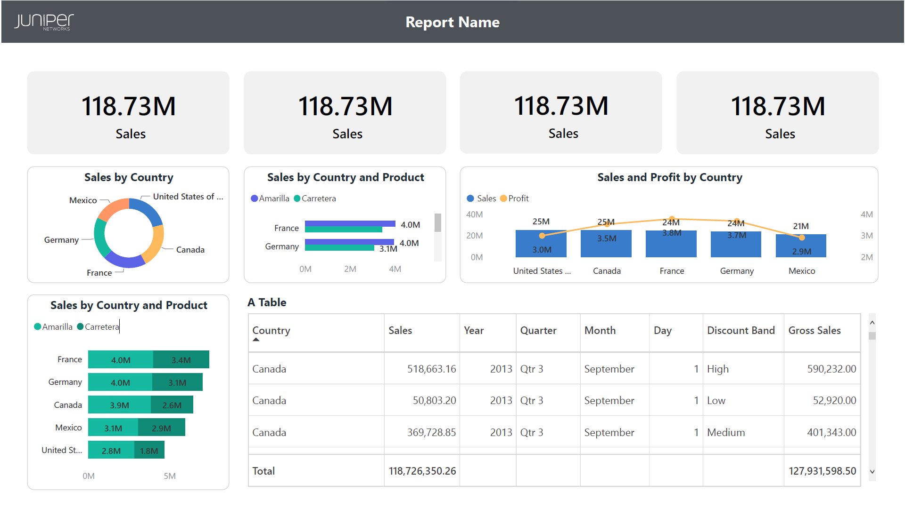
Report Mock-up

Slide 34
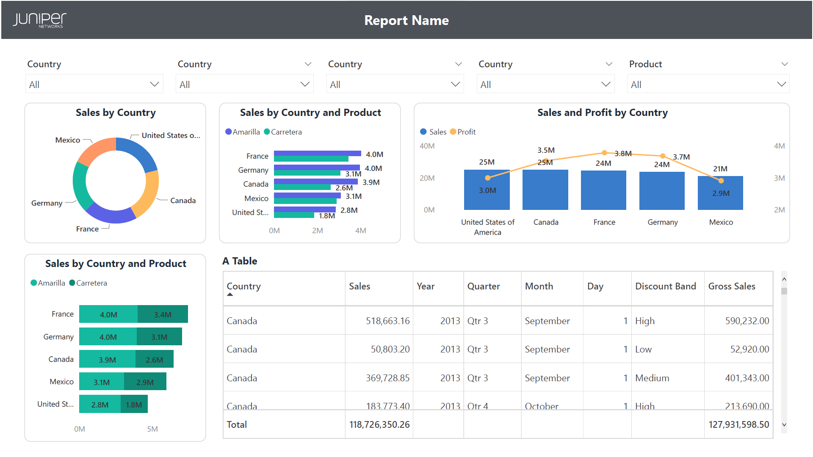
Report Mock-up

Slide 35
User Flow

Slide 36


Salesforce Embedded Portal (User Experience)
To access this page, you must log-in to Salesforce
Username
Password
Log In to Sandbox
Remember me
Forgot your password?

Slide 37
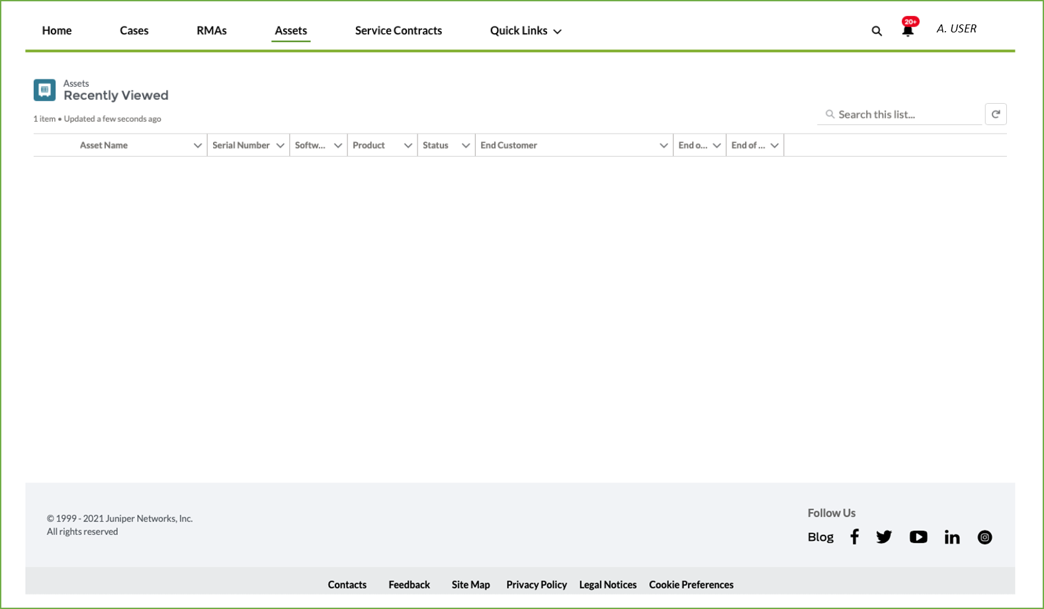
Salesforce Embedded Portal (User Experience)

Slide 38
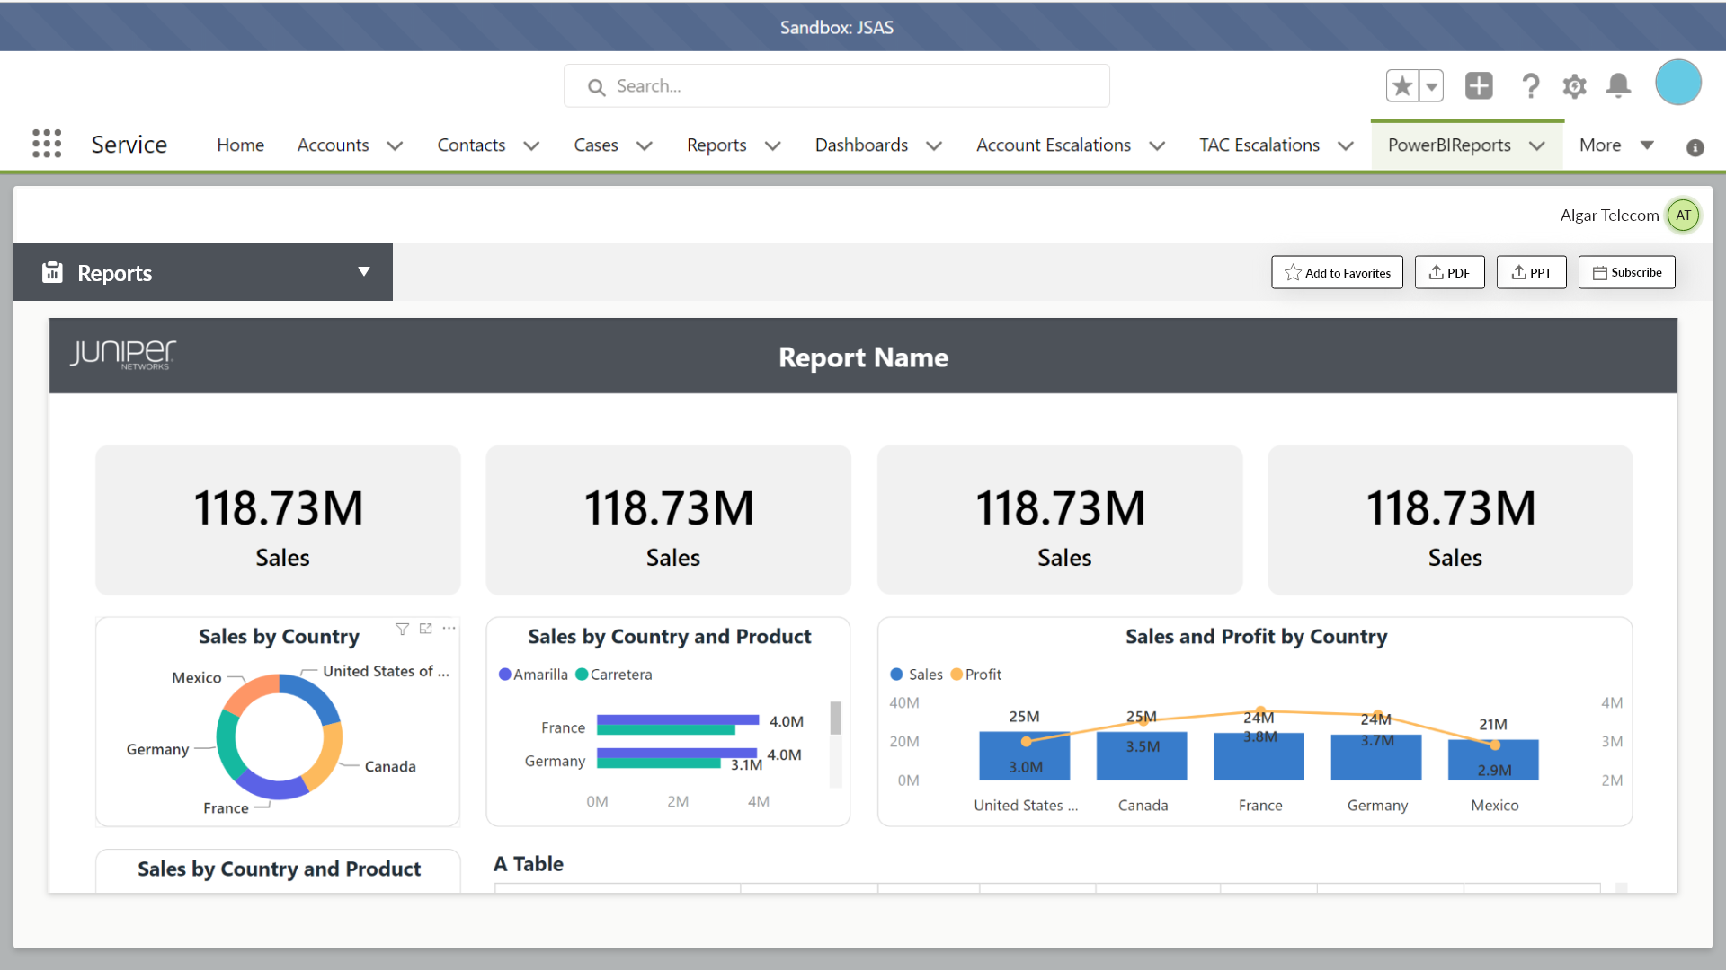
Salesforce Embedded Portal (User Experience)

Slide 39
Salesforce Embedded Portal (User Experience)

Slide 40
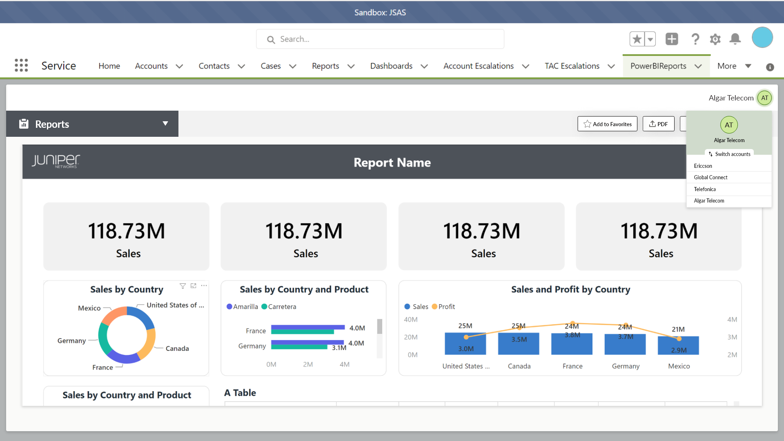
Salesforce Embedded Portal (User Experience)
Creating and populating the account ID dropdown is owned by Juniper

Slide 41

Salesforce Embedded Portal (User Experience)

Slide 42
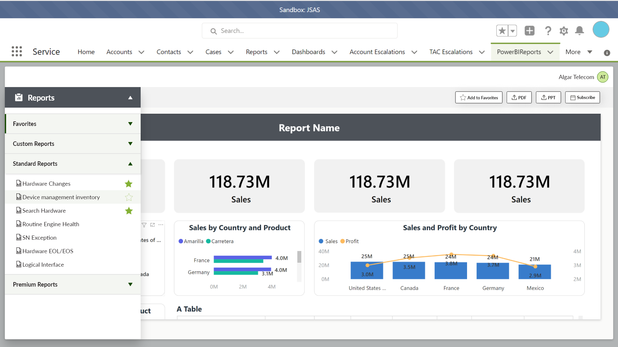
Salesforce Embedded Portal (User Experience)

Slide 43
Salesforce Embedded Portal (User Experience)
Hover over this area to see the Favorite icon and click to mark it as Favorite

Slide 44
Salesforce Embedded Portal (User Experience)
You can use this option as well for marking the reports as Favorite

Slide 45
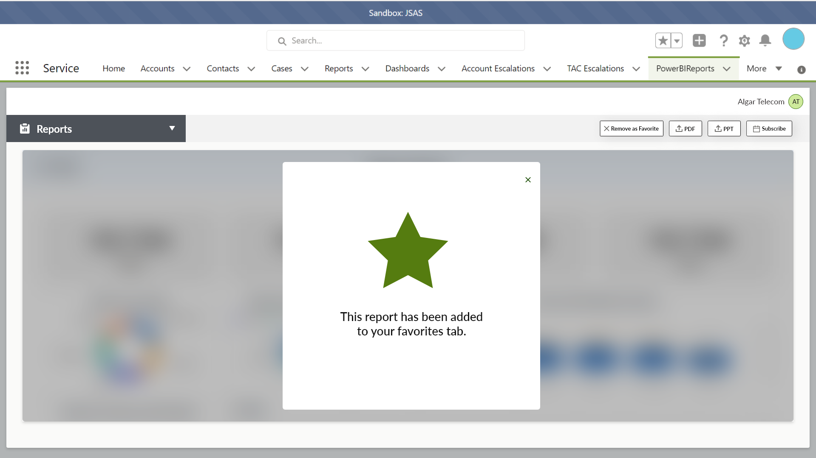
Salesforce Embedded Portal (User Experience)

Slide 46




Salesforce Embedded Portal (User Experience)
Search Hardware.pptx
Show All

Slide 47
Salesforce Embedded Portal (User Experience)
Search Hardware.pptx
Search Hardware.pdf
Show All

Slide 48

Salesforce Embedded Portal (User Experience)

Slide 49
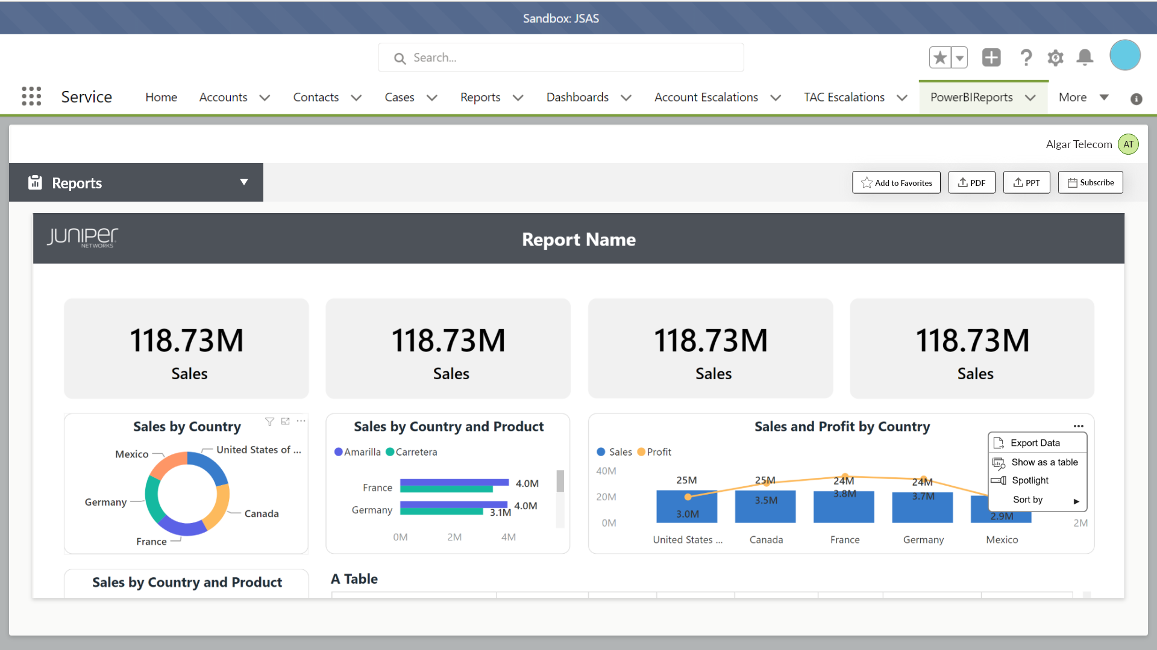
Salesforce Embedded Portal (User Experience)
This provides export functionality in Excel and CSV format (OOB)

Slide 50
Salesforce Embedded Portal (User Experience)

Slide 51
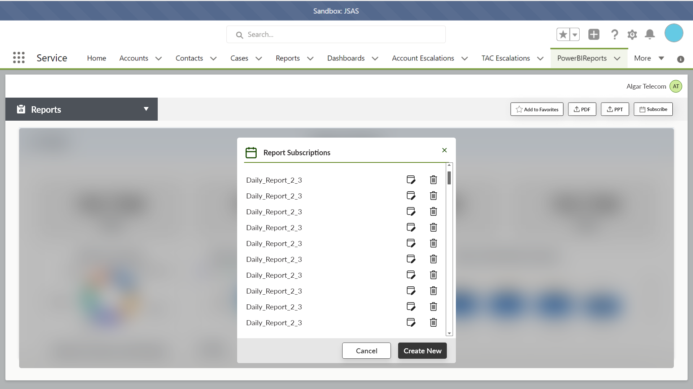
Salesforce Embedded Portal (User Experience)

Slide 52
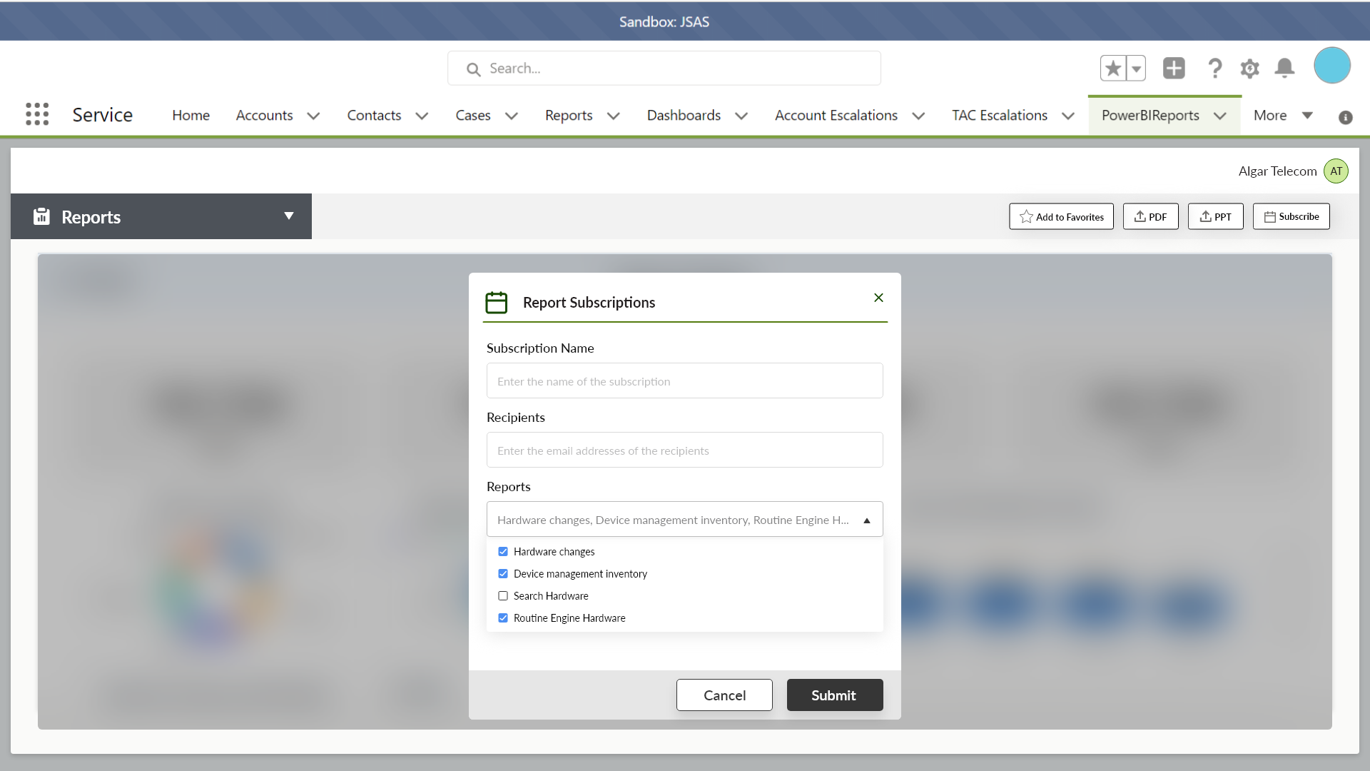
Salesforce Embedded Portal (User Experience)

Slide 53
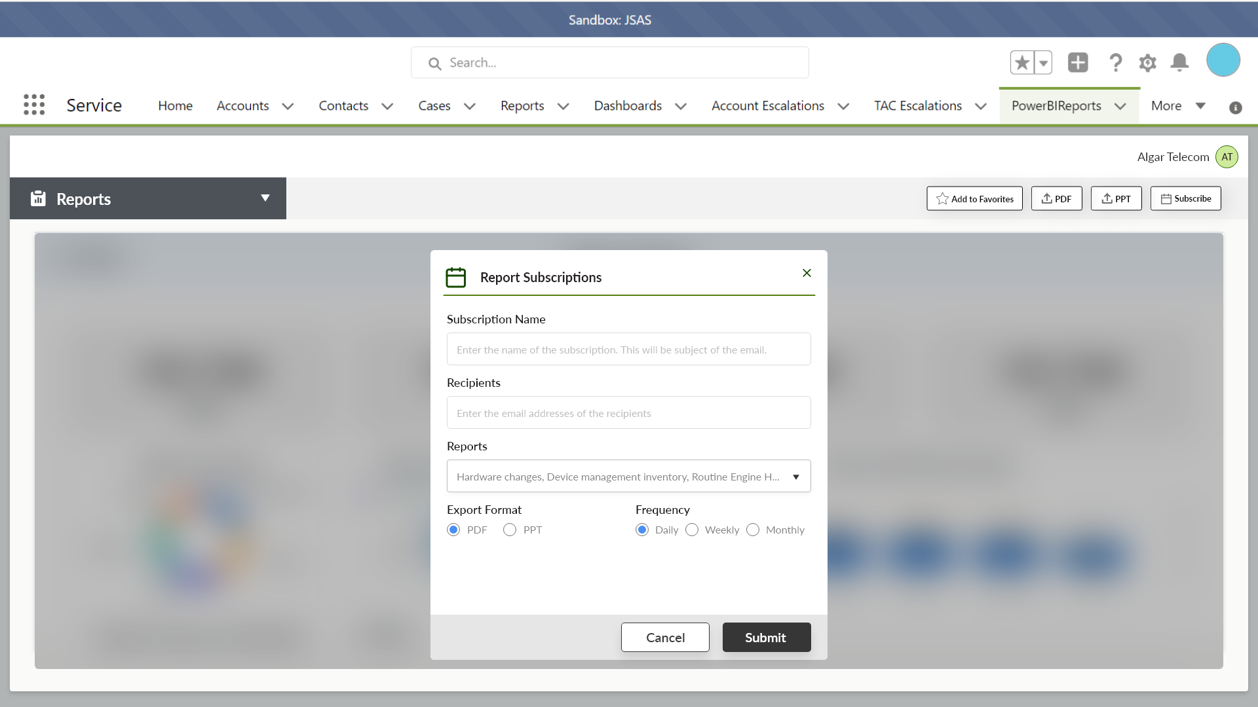
Salesforce Embedded Portal (User Experience)

Slide 54
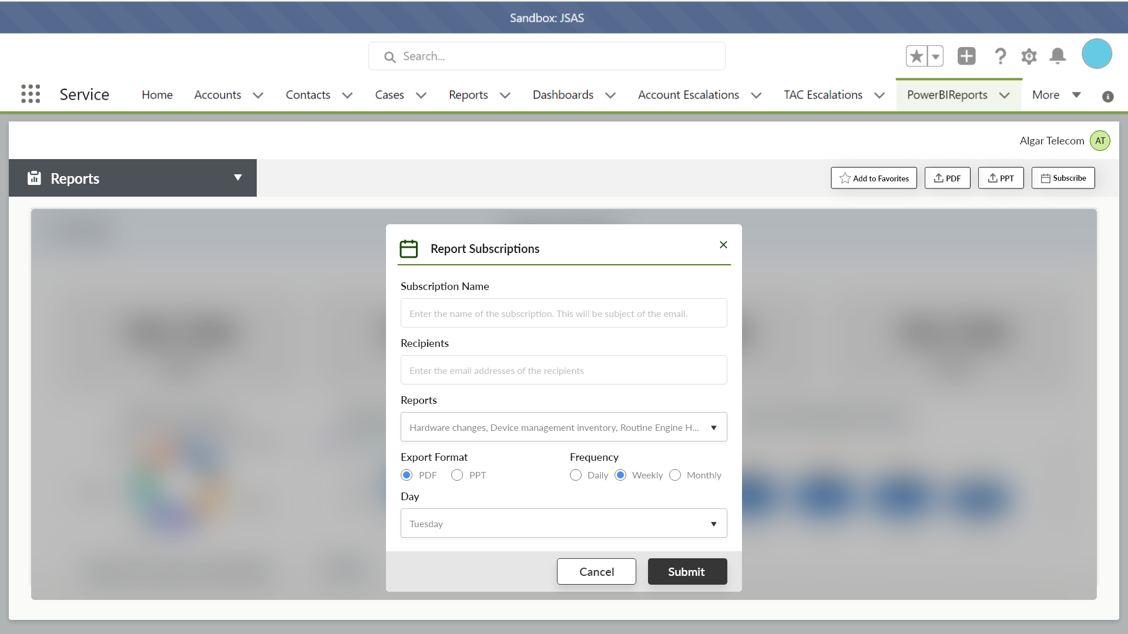
Salesforce Embedded Portal (User Experience)

Slide 55

Salesforce Embedded Portal (User Experience)

Slide 56
Salesforce Embedded Portal (User Experience)

Slide 57
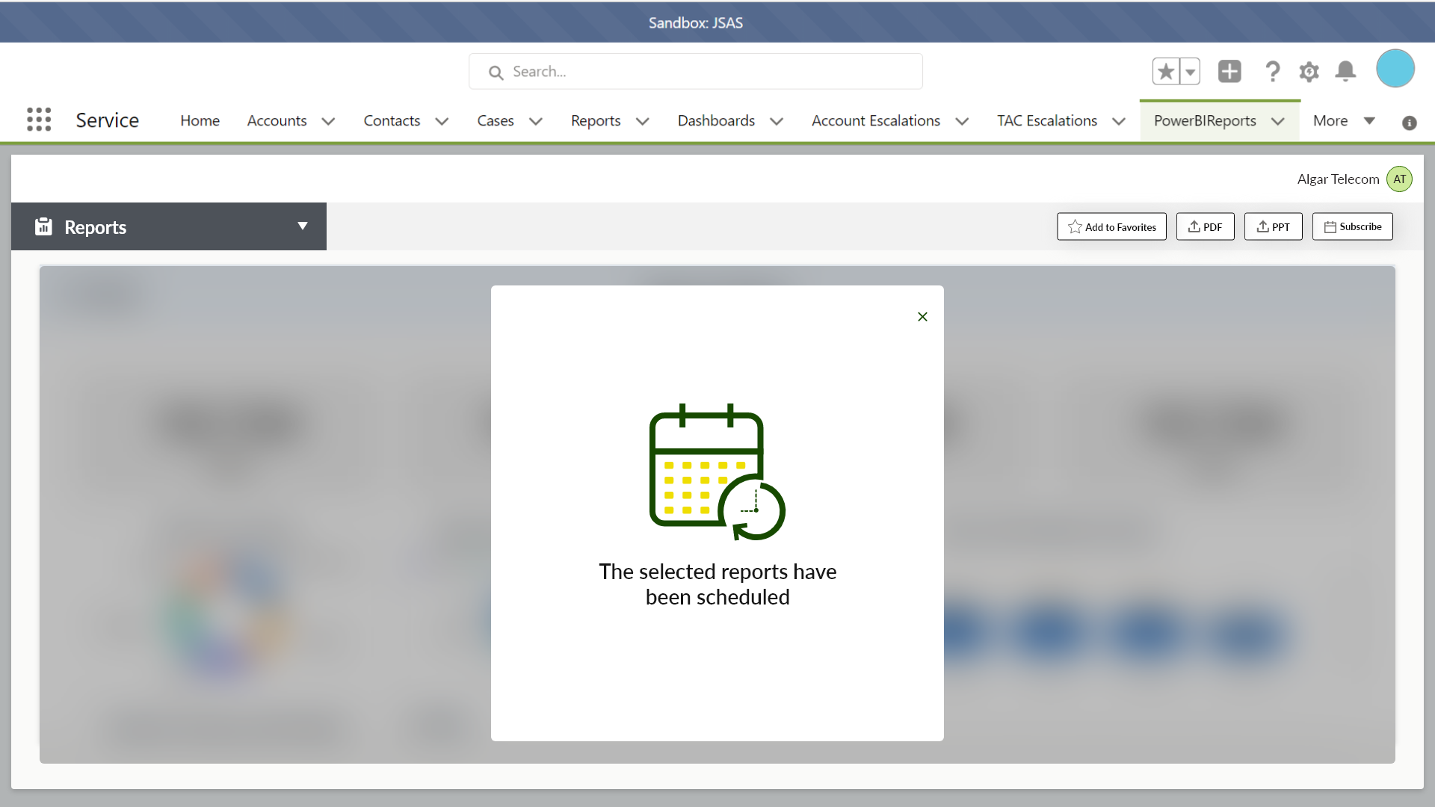
Salesforce Embedded Portal (User Experience)

Slide 58
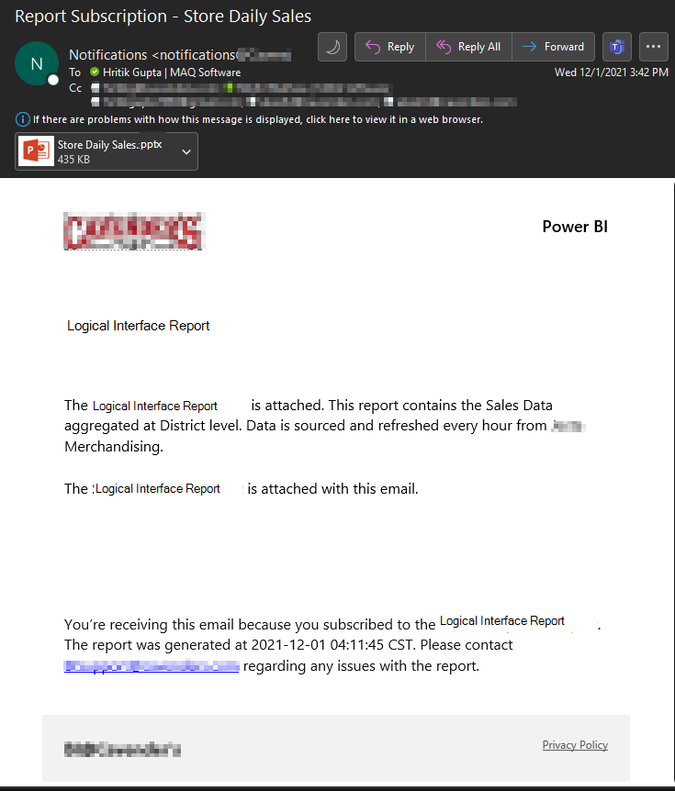


Report Notification: Logical Interface Report
Logical Interface Report.pptx
Logical Interface Report
Link to access Logical Interface Report is attached. This report contains the information related to logical interfaces, their device groups and hosts
Link to the registration portal will be added here
Logical Interface Report
You’re receiving this email because you subscribed to the Logical Interface Report. Please contact Juniper Support regarding any issues with the report
Only Juniper registered users can access the reports. Please go to ___ to register into Juniper

Slide 59
Scope Review

Slide 60
8.2 Enterprise System Integration
Requirement Type | Requirement | Details | Implementation in Solution
INT-01 | Salesforce lightening component | The solution needs to offer the capability to integrate into Salesforce lightening components. Reports can be seen from the Salesforce portal without the need to switch to the reporting tool. Dashboard view needs to be embedded into the portal. Filtering and rendering needs to be tested. There are different user types Customer – can see only their data Partner (PAR) – can see the data of the customers they are associated to via the service relationship Customer advocate user – can see the data of the customers for which they are on an account team JTAC /Global support user – can see data for all accounts Customers can have different roles (standard / admin/ power user) which will have different capabilities with regards to the reports (view only / edit / create). Rendering may be at multiple levels. A full dashboard with sub reports (primary goal) Individual reports Components of a report (e.g. we may want to visualize a chart somewhere in SFDC environment). (Secondary goal) Juniper will provide the appropriate data key (usually the AccountID, or AccountID and Device Serial Number) from which the Vendor system will determine which report or report component to visualize. | Salesforce Embed Widget with Power BI reports and accounts dropdown Accounts dropdown will be populated by the Juniper team based on user access Reports available to the account will be rendered on selecting account Permissions utility for maintaining access on Power BI Workspaces Not supported: Individual visuals/ components for a report
 | Not in scope

Slide 61
8.2 Enterprise System Integration
Requirement Type | Requirement | Details | Implementation in Solution
INT-02 | Office365 Suite (Teams, SharePoint, Power Apps) | Reports can be accessed from Teams or SharePoint. Reports can be exported as PDF or Excel spreadsheets. Reports or data from reports can be accessed by Power Apps. | Export to PDF/PPT functionality on SFDC portal #1 and #3 are OOB functionalities in Power BI Export to Excel/CSV is OOB at visual level
INT-03 | Data API | Provide API that allows data to be queried in a programmatic way. Ability to manage data lifecycle that is cashed or persisted in the Vendor system/platform. | OOB of Power BI capability to get data from data model
INT-04 | Data Backend | Integration to Snowflake and AWS. Juniper will provide access to materialized views for each customer account. The Vendor system needs to tell Juniper how we can communicate the instantiation of these materialized views. A stored procedure exposed by the Vendor system could be the method. This will trigger the Vendor system to create the reports (and refresh regularly) the report for each Customer Account ID. Schedule Management: Set, unset schedules for extracts / pulls from Snowflake Ensure that schedules are not too clustered around the same time period impacting general performance of the application. | API Endpoint is exposed for customer provisioning Juniper team will invoke the endpoint with the customer id Extracts/Pulls from Snowflake are controlled using Power BI OOB refresh functionality
INT-05 | ODATAv4 data sources | Support for ODATAv4 data sources | Power BI OOB connectors are available
 | Not in scope

Slide 62
8.2 Enterprise System Integration
Requirement Type | Requirement | Details | Implementation in Solution
INT-06 | Juniper User Authentication and Authorization systems | SFDC is master of all AAA, the Vendor SaaS is a delegate of SFDC. Support and integration with Juniper User Authentication and Authorization systems (SSO). Integration with SFDC for authentication. - External users – OKTA - Internal users – LDAP (ADFS) Automatically assigned role-based access granted to users for view, configure or customize access to reports | Reports can be accessed only through SFDC thereby adhering to existing security protocols Utility for maintaining access on Power BI Workspaces for edit/create will be managed using the SFDC custom object with permissions info created by Juniper team
INT-08 | Link level integration | Web hook to access external web sites: Right click to create a case in Juniper Support Center, pulling though data (serial number, device type, etc.) to populate case. Drill down options to reports Search on item in Report – e.g. Serial Number Link to webpage – e.g. to Juniper EOL web page, from EOL data in a Report. | External link for accessing Juniper Support portal is added on the required report Search functionality is present on Power BI reports for required slicer as OOB functionality Drilldown option in required reports can be enabled as this is supported OOB in Power BI
INT-08 | Multiple Account IDs | Juniper will send the Vendor system the customer Account ID to serve as the data key to determine which reports to render. In the case where multiple Account IDs are sent, the user should have the ability to see an aggregate view (all customer Account IDs) or choose from a multi-select menu should they want to narrow down their data view. | Accounts dropdown available on SFDC portal as per access Account dropdown will be created as a single select drop down.
 | Not in scope

Slide 63
8.3 Licensing
Requirement Type | Requirement | Details | Implementation in Solution
LM-01 | Management of users | On/Off-board, transition. Provisioning of users, license usage tracking Includes the following: onboarding users, decommissioning users, granting users access to appropriate accounts/folders/dashboards, manage access (if a new customer account is added and an existing partner has access to this customer, the partner’s access should be enhanced to include this new addition). | Utility for maintaining access on Power BI Workspaces for edit/create using the SFDC custom object created by Juniper team The utility will be configured to run daily
LM-02 | User types, logging & auditing. | Support must include but not limited to the following roles: Infrequent User: Users who visits the web-embedded visualization experience once or less than once per quarter. Regular Users: Users who visit the web-embedded visualization experience on a regular basis (daily, weekly, monthly, etc.) Power Users: Users who leverage the desktop application to create or modify reports. Super User: Juniper administration user able to perform all/any actions for all customers. This is a highly restricted roles. All actions must support logging and auditing to provide a view of what has been view/changed by users including timestamp, and source along with other logging/auditing information. | Usage metrics is surfaced in a Usage Report using logs from Application Insights
 | Not in scope

Slide 64
8.3 Licensing
Requirement Type | Requirement | Details | Implementation in Solution
LM-03 | License pricing models | Price tiers for different user types. Regular users pricing based on usage. Cost for Regular Users who log in sparingly (monthly for example) should be priced differently than for those who use the portal daily. This should be a usage-based pricing model that is competitive in the market. Power user cost to be market competitive No cost for one-time users (viewers) | This is not a part of Power BI Widget
 | Not in scope

Slide 65
8.4 Audits
Requirement Type | Requirement | Details | Implementation in Solution
- | - | Provide capability to audit the Vendor system usage according to Juniper security practices which includes periodic review of developer access, review of role-based access implementation, review of applied permissions for the protection of data and assurance of encryption at rest and in transit. Specific review of privileged access (PAM). The verification of the segmentation of users and data. | Access can be reviewed and monitored on Azure and Power BI portal. Juniper team has administrator access on these systems already.
 | Not in scope

Slide 66
8.5 Life Cycle Management
Requirement Type | Requirement | Details | Implementation in Solution
LFC-01 | Capacity Management | The vendor should provide the client knowledge on capacity management, permissible upload and download limits, the calendar restraints to these etc. As such, there must be a warning if any thresholds are in range of being crossed. | Azure Alerts will be setup on Power BI Service Risks and assumptions will be called out in the architecture slide deck. This will be called out as a part of the hand off activities
LFC-02 | Exception process management | There should be an ability to auto-terminate long running jobs that are cannibalizing the system or allow administrative oversight on exception processes. | Refreshes that are running too long can be monitored on Power BI refresh schedule. Exceptions raised during refresh will be visible on the Power BI portal
LFC-03 | Metrics/SLA | Provide SLA and metrics to monitor system performance. Is there a way to recommend best practices on queries used? | System performance can be monitored on the capacity metrics app
LFC-04 | Upgrades & compatibility | Upgrades and patches to the system should be vendor managed – there should be backward compatibility release notes to the client. | GitHub pipeline will be created for incremental deployments
LFC-05 | Admin responsibilities | There should be a gradation of administrative rights – an overall site admin, folder admins etc | Per discussion, super admin role will have access across the workspaces and access to perform incremental deployments
LFC-06 | Access Validation | The system should provide the capability of being SSO compliant. | Supported OOB by Power BI
LFC-07 | Integration to Cloud | If hosted on one of the major cloud providers (AWS/GCP/Azure) – the tool should provide the capability to be embedded with Juniper’s VPC. | Power BI embed widget is embedded in existing SFDC portal
 | Not in scope

Slide 67
8.5 Life Cycle Management
Requirement Type | Requirement | Details | Implementation in Solution
LFC-08 | Location of Vendor instance to be provided | - | Cloud resources are being provisioned in West US
LFC-09 | Infrastructure and Service Management | Ensure availability and access to the system throughout business hours across all geographies supported by Juniper and its associates Respond and service incidents, tickets with agreed to SLAs Manage stakeholder communication as well as coordination with the Vendor in the event of planned or unplanned outages Work with vendor for piloting beta or preview features as needed. Juniper requires two separate instances/environments (development and production) with pre-defined SLAs for each. The solution will comprise of two ecosystems: Canned/Golden Reports: These will be managed and controlled by the Apex-EP core team. These can be thought of as the “golden reports”. For this Juniper requires two separate instances (development and production) with pre-defined SLAs for each. Custom Reports: These will be based on the Canned Reports. Account facing people (Service Managers, Resident Engineers, etc.) will be able to build custom reports for their customers | Power BI Service has a 99.9% availability SLA SLAs to service tickets are governed based on EA with Microsoft team. Dev, Staging and Production environments are provisioned. Canned/Golden reports can be managed and deployed from GIT repository and pipelines. (Different version of Standard reports) Power users will be able to deploy custom reports. Access for Power Users will be managed using the SFDC custom object shared by Juniper team.
 | Not in scope

Slide 68
8.5 Life Cycle Management
Requirement Type | Requirement | Details | Implementation in Solution
LFC-10 | User Management | Onboarding users Decommissioning users Granting users access to appropriate accounts/folders/dashboards Manage access (if a new customer account is added and an existing partner has access to this customer, the partner’s access should be enhanced to include this new addition) | Permissions utility for maintaining access on Power BI Workspaces for edit/create using the custom object created by SFDC team Utility for de-commissioning user access
LFC-11 | Schedule Management | Set, unset schedules for extracts / pulls from Snowflake Ensure that schedules are not too clustered around the same time period impacting general performance of the application | Power BI refreshes can be set/unset using OOB Power BI functionality
LFC-12 | Capacity and compute management | Assign workspaces to capacity Manage workloads to configure and optimize memory usage Restart capacity | Capacity management is done as a part of customer provisioning pipeline Workload management and ability to manage the capacity is provided OOB by Power BI
LFC-13 | Audit Management | Manage access to Vendor administrative/management tools Enable, disable, and manage access to the Vendor features Report usage and performance. Take corrective measures on optimizing performance as needed. Review and manage auditing. | Power BI provides ability to enable/disable certain features Performance optimization/monitoring can be done using capacity metrics app
 | Not in scope

Slide 69
8.5 Life Cycle Management
Requirement Type | Requirement | Details | Implementation in Solution
LFC-14 | Administrative APIs and SDK | Build custom admin tools. e.g. Build usage reports that indicate how often dashboards are accessed and by whom, trends on the same and aggregation of results across partners Work with developers to leverage above APIs to build reports based on data related to administration | Usage report will be created
LFC-15 | Core Vendor Activities | Manage workspaces Publish Vendor visuals Verify code used to embed Vendor in other applications Ensure quality of service Troubleshoot data access and other issues Acquire and work with Premium capacity | Solution performs workspace management for individual customers and publishes standard reports Code will be shared with Juniper team. Power BI Embedded capacity will be used for provisioning
LFC-16 | Planned/ Unplanned Outages | SLAs and standard communications for Planned and Unplanned outages | SLA's and communications for planned/unplanned outage will be based on cloud service
LFC-17 | Administrative access (privileged internal user) | Named user internal account emergency use. Juniper requires the privileged administration access directly with the Vendor system. Commercial agreements for use of the Vendor system/solution will also be direct between Juniper and the Vendor. In case a partner is used by the vendor, the partner is the integrator and system configuration partner only | Juniper is admin on Power BI and the Azure subscription
LFC-18 | Disaster Recovery | Should follow standard cloud protocols and recovery agreements in the event of unforeseen circumstances. | Standard Power BI reports are available in the Git Repository Custom Reports created by Power Users maintained by Power Users
 | Not in scope

Slide 70
8.6 Security
Requirement Type | Requirement | Details | Implementation in Solution
SEC-01 | Access Control - Identification and Authentication | The Vendor system/software will follow the Principle of Least Privilege when giving access to developers and will ensure that privilege access is managed and that administrative accounts are minimal and kept to only what is necessary. All access will be logged, and the Vendor systems/software will do periodical reviews of developer access, login attempts. Juniper requires SSO and MFA to be implemented. | Access is currently managed by Juniper IT team Solution uses SSO and MFA from existing Salesforce portal
SEC-02 | Security Audit and Accountability | Provide capability to audit the tool usage according to Juniper security practices which include periodic review of role-based access (non-developers cannot develop for example), review of role-based access implementation, review of applied permissions for the protection of data and assurance of encryption at rest and in transit. Specific review of privileged access (PAM). The verification of the segmentation of users and data. Dashboards and Reports will log usage and any errors. | Access can be reviewed and monitored on Azure and Power BI portal. Juniper team has administrator access on these systems already.
SEC-03 | Dashboards and Reports Development | The Vendor system/software will follow best practice security for the Vendor Platform: Enable Row-Level Security Use only certified custom visuals Categorize report data by business impact | Account/ Customer specific datasets are maintained in separate workspaces Custom visuals will be shared with Juniper team prior to being used
SEC-04 | System and Information Integrity) | The Vendor system/software will ensure that the Vendor instance within Juniper is following Cloud Security Best Practices | Infosec review and sign-offs for every component
 | Not in scope

Slide 71
8.6 Security
Requirement Type | Requirement | Details | Implementation in Solution
SEC-05 | Security Incident Response | The Vendor system/software (or Vendor) will immediately notify Juniper of any security incidents and any specific data breach that might be impacting Juniper data. | Infosec sign-off
SEC-06 | Data at Rest | The Vendor system/software will use encryption for data at rest. | Data is present within Power BI and maintained with enterprise level security
SEC-07 | Data Transmission | The Vendor will provide secure transmission of data between source and target - (HTTPS/TLS 1.2 in transit, SFTP/secure MFT for any batch integration requirements). | Data transmission is managed by Power BI with enterprise level security.
SEC-08 | Data Access | The Vendor system/software will provide secure access to the data through strong authentication methods and role-based access control. | Data transmission is managed by Power BI with enterprise level security.
SEC-09 | Data Security & Visibility | The Vendor system/software will ensure the separation of data between different customers is maintained. | Separate workspaces for each customer
SEC-10 | Data Cache Control – (enable appropriate configuration for secure caching) | Vendor web servers Cache-Control directive set to no-store (client cache) Data Query Cache – default is query caching off Dataset Cache – will not cache based on above Dashboards that are using RLS data source only cache but goes back to the RLS data source for access the data | Managed by Power BI platform
 | Not in scope

Slide 72
8.7 Training
Requirement Type | Requirement | Details | Implementation in Solution
T-01 | Core Vendor product training. Direct Training | Training to Juniper covering the Vendor core product, configuration, administration, integration, and customization capability. The purpose is so that Juniper IT & GS team are familiar with core features and capability of the Vendor products used. Target audience is Juniper IT and Global Service teams. This may be delivered/available by the Vendor standard training or if not available or suitable separate training to be provided by the Vendor or their agent | DIAD session will be conducted
T-02 | Implemented Vendor solution training/transfer of information (TOI). Direct Training | Training/TOI required on the implemented Vendor solution, configuration, integration, workflows, and reports templates/migrated reports. The purpose is so that GS & dev teams can extend and develop post initial deployment. This should include all documents necessary for ongoing support and maintenance of the solution by the Juniper team. Target audience is Global Services & dev teams. | DIAD session will be conducted
T-03 | TAC/Support training. Train-the-Trainer | Training for Juniper TAC covering initial triaging and troubleshooting support prior to handing off, and on mechanism for monitoring the Vendor system/cloud/service status. Target audience is Juniper TAC leads. | DIAD session will be conducted
 | Not in scope

Slide 73
8.7 Training
Requirement Type | Requirement | Details | Implementation in Solution
T-04 | Report Use & Customization training framework. Train-the-Trainer | Provide and work with Juniper on a training framework and outline methods for end user customization of reports, and standard reports access/use. Target audience is Global Services team and Global Service Customer Theater leads. Note, the purpose here is to empower Juniper team in a train-the-trainer fashion, rather than to actual end user delivered training by the Vendor. | DIAD session will be conducted
T-05 | Training assets/material. | All training assets/material to be provided to Juniper so that they can be used by Juniper and/or incorporated in Juniper internal and customer training. | DIAD session will be conducted
T-06 | Training Delivery | All training should be in the form of recorded training videos and documentation. All trainings to be delivered twice to allow for users around the globe to attend. | DIAD session will be conducted
 | Not in scope

Slide 74
8.8 Product Support
Requirement Type | Requirement | Details | Implementation in Solution
- | - | Juniper requires premium level support from the Vendor, with access to a Customer Success Manager. The Vendor will warranty their solution for a period of 1 year after delivery. Any Severity 1 (Showstopper) defects will be resolved within 1 business day and Severity 2 (Critical) within 1 business week, after reporting to the Vendor The Vendor will provide appropriate contract information to report issues. Juniper will be able to renew the Vendor warranty on a yearly basis should that need exist. Access to knowledge base, training material and other support related information. | Support for the cloud services being used will be based on the EA with Microsoft.
 | Not in scope

Slide 75
8.9 Report Content
Requirement Type | Requirement | Details | Implementation in Solution
R-01 | Migration and enhancement of existing Operational Dashboards & Reports | The following Dashboards & Reports, currently in Tableau, must be migrated, enhanced and available for end users (Juniper customers & Juniper customer supporting teams) to access and use. Launch Pad – linked lists all the currently available Dashboards & Reports by title/reference and includes a report description. The current launch pad is primitive and needs enhancement to provide a slicker customer experience. This need to be dynamic as/when there are changes. Std Report 01: Landing Page – summary Operational Daily Health Dashboard Std Report 10: Hardware Inventory Std Report 11: Search Hardware Std Report 12: Compare Hardware Std Report 20: Physical Interfaces Std Report 21: Logical Interfaces Std Report 30: Alarm Details Std Report 70: Hardware EOL/EOS Status Std Report 80: Device Management Inventory Std Report 81: Commit History Std Report 82: Routing Engine Health Std Report 90: Systems Report Std Report 91: Serial Number Exception Subject to timing of the engagement there may be additional reports that need to be included as the solution is in active use and on-going development. The final set will be shared/agreed prior to start of engagement. | 14 std reports will be available on SFDC Portal: Launch Pad - Lists all the currently available Dashboards & Reports by title/reference and includes a report description. Use the Navigation Bar for accessing the reports. Std Report 01: Landing Page Std Report 10: Hardware Inventory Std Report 11: Search Hardware Std Report 12: Compare Hardware Std Report 20: Physical Interfaces Std Report 21: Logical Interfaces Std Report 30: Alarm Details Std Report 70: Hardware EOL/EOS Status Std Report 80: Device Management Inventory Std Report 81: Commit History Std Report 82: Routing Engine Health Std Report 90: Systems Report Std Report 91: Serial Number Exception
 | Not in scope

Slide 76
8.9 Report Content
Requirement Type | Requirement | Details | Implementation in Solution
R-02 | Vendor/ Operational Dashboards & Reports embedding in Salesforce Portal. | Provide guidance, support, and best practice to Juniper Portal dev & Reporting teams on embedding of the Vendor/Operational Dashboards & Reports into the Apex Essential Portal (Salesforce community portal). | DIAD session will be conducted
R-03 | Vendor/ Operational Dashboards & Reports embedding in Salesforce Portal. | The following additional Dashboards & Reports, currently in Tableau, must be migrated and available (for use by Juniper internal teams). Adoption Reports: APEX-AA Adoption Dashboard These reports are for internal consumption to monitor/track overall customer service adoption and state. Primarily customer device volume (of configured, collected devices), and by Juniper product family (EX, MS, PTX). Presented and filterable by period, by customer and customer segmentation. Subject to timing of the engagement there may be addition reports that need to be included as the solution is in active use and on-going development. The final set will be shared/agreed prior to start of engagement. Reports enhancements and improvements, from current tableau implementation, to embrace and leverage the Vendor data visualization features and capability. Reports available on request/start of engagement. For reference, this is an extension of the POC use case (Use Case 4: Present Adoption Dashboard), for fuller implementation in production environment. | Adoption report will be created
 | Not in scope

Slide 77
8.9 Report Content
Requirement Type | Requirement | Details | Implementation in Solution
R-04 | Creation of Usage/Adoption Reports | Creation of adoption/usage reports covering Dashboards/Reports usage metrics at a summary (aggregation) and detail (to individual user); e.g. . These reports are for Juniper internal use, e.g. Product Management, Administration & Customer Success teams. Dashboard/Report views Dashboard/Report Downloads Time spent on Dashboards/Reports Top n reports. Active/Inactive users User flow Optional (if possible): Capability to search activity per user By individual users, by customer, by overall user community. Further filtering by customer segmentation (e.g. theater, region, segment, type). For specific date, fixed period week/month/quarter and configurable period. Along with other recommended metrics to help assess and evaluated use and adoption | Usage report will be created with the metrics defined
R-05 | Alignment to Juniper & Apex brand/style guidelines. | All Dashboards & Reports must comply with Juniper branding, corporate standards, and overall Apex portfolio guidelines. Work with Juniper Global Services UX team based on brand, corporate and Apex portfolio guidelines. | Please share the APEX portfolio guidelines UI/UX mock-ups are created using brand colors and shared with Juniper for approval as a part of architecture slide deck
 | Not in scope

Slide 78
8.9 Report Content
Requirement Type | Requirement | Details | Implementation in Solution
R-06 | Final Dashboard/Report Approval | All Dashboards & Reports to be reviewed by Business Users SMEs. Feedback to be incorporated in updated and enhanced Dashboards & Reports. Final sign off will be performed by Business Stakeholders. | UAT phase called out in the plan for all the elements. We have considered a two-week UAT window
R-07 | TOI | As part of the migration the Vendor must provide TOI to Juniper Global Service and Dev team for the team to able to maintain and update reports. [Also covered in Training section, T2]. | KT sessions and corresponding videos will be provided
R-08 | Automated provisioning customer Dashboards & Reports | Provide a mechanism and integrate with the new customer provisioning/onboarding process, to automatically deploy the standard Dashboards & Reports and customer personalization, e.g. adding a customer logo. For reference, this is an extension of the POC use case (Use Case 5: Customer Provisioning (Dashboard & Reports)), for fuller implementation in production environment. | Customer Provisioning pipeline for new customer. API endpoint will be invoked by Juniper team for provisioning
 | Not in scope

Slide 79
8.9 Report Content
Requirement Type | Requirement | Details | Implementation in Solution
R-09 | Standard & Custom Report Management | Provide a mechanism and framework to manage standard & custom reports. Standard report consists of a set of standard reports, based on the initial set migrated and further additions. Reports must be versioned. Users to be notified of new or updates to reports and new versions. Custom reports can be created by Juniper power user, e.g. through cloning and customizing/configuring existing report of building a new report from the available data that is associated with a customer account. Custom reports may be internal or published to other customer users. | Reports versions maintained in GitHub Access provided to Power Users/ Super Users on Power BI Workspaces for edit/create: Custom Reports Premium Reports Updates to existing reports Users will be notified of new reports by highlighting on the portal
R-10 | Internal Access & User Authentication | Support internal user access and authentication (through Juniper userid corporate SSO) for internal users/reports (e.g. for Adoption/Usage reports [ref R 2. & 3.]), separate to the above Operational Dashboards & Reports categories [ref R1]. These reports need to be managed separately and not accessible by external users. Examples of reports may be: Service Renewal Report, JTAC Reports. | This will be supported by the visibility control for the reports
 | Not in scope

Slide 80
8.9 Report Content
Requirement Type | Requirement | Details | Implementation in Solution
R-11 | Initial Creation of set of report/data actions | Advise on means to create, actions embedded in/from Dashboards/Reports. The initial set of actions to include: hyperlink to Juniper EOL page for specific EOL product in the EOL report. Juniper Support Recommended Version page in the DMI reports. Specific Juniper Product Information page in HW reports ‘right click’ to raise case in Apex Support Portal with pull through on device instance data (serial number, etc.). ‘right click’ to open Apex Support Portal corresponding device Install Base record for a given device serial no, for example from HW reports. For reference, this is an extension of the POC use case (Use Case 3: Perform Action), for fuller implementation in production environment. | Link to Juniper Support portal is present on the Power BI report Link to Knowledge Base is present on EOL/EOS report Other custom actions will not be a part of Phase 1
R-12 | Creation of Data Viz widget | Creation of data viz widget (small web frame within a larger web page) from section of Dashboard/Reports that can be exposed and integrated into Apex Support Portal (Salesforce Community and Service Cloud). For example, a widget showing connected device summary/details/link that can be embedded in Apex Support Portal Case page for a case against a specific device/serial no. Juniper should have the ability to add, change and improve the visuals that appear in this widget. Details of widget to determine based on available device data. | Power BI embedded can be used to embed a dashboard or report on other applications
 | Not in scope

Slide 81
8.10 Additional Data Visualizations and UX Requirements
Requirement Type | Requirement | Details | Implementation in Solution
REP-01 | Able to Schedule Reports and Dashboards | Dashboards and data download can be scheduled. Frequency of hourly, daily, weekly. It can be scheduled directly to email or ftp/SharePoint/google docs/etc. location. Support different notification mechanisms (mail, IM/chat, automation tool, slack, etc.) | Notification scheduler feature only supports PDF and PPT exports in Phase 1 ftp/SharePoint/google docs/etc are not supported in Phase 1
REP-02 | Version Control | Keep a backup copies of last versions and be able to define each version. Comparison of metadata. | Standard and premium reports are maintained in GitHub Custom reports are maintained by Power Users
REP-03 | Sensitivity Marking | Must be able to include/display a sensitivity/confidentially marking on the dashboards/reports in all forms (electronic and print). | Sensitivity label can be marked on the Power BI portal for reports
REP-04 | Data Export Capabilities to different formats | Standard formats excel, csv, xml, pdf. | PDF and PPT formats are supported in: Report Notifications On-Demand exports on SFDC Portal Excel/ CSV data exports are supported for visuals OOB by Power BI
REP-05 | Connection to different data sources | Connection to different sources is needed when there is a need to join data from separate sources such as sfdc, snowflake, etc. … Joining and blending of data from various sources directly or using custom sql. | Snowflake data source is considered in phase 1
REP-06 | Core reports to be template driven | Std reports, Custom reports, and Dynamic reports. Select from a set of reports, which one you want to look at. | End user has the ability to select standard, custom and dynamic reports from report navigation
 | Not in scope

Slide 82
8.10 Additional Data Visualizations and UX Requirements
Requirement Type | Requirement | Details | Implementation in Solution
REP-07 | Data Quality Audit process | Data quality between the systems needs to be checked and audited. | Power BI reports created will be validated. UAT will be performed for additional review of the data.
REP-08 | Pro-active monitoring process | Early monitoring mechanism to find if something is failed or not working at the customer portal. | Azure Alerts will be setup. Notifications will be set up for Power BI refresh
REP-09 | Usage of data, who is looking at the reports. | For customer success and usage analysis can see usage (who, how, when). There should be standard usage analytics reports as well as the ability for admin to customize. | Usage report will be created as per the defined guidelines
REP-10 | Migrating of existing Tableau dashboards into selected solution or another tool | Support migration from existing reports/dashboards (based on standard formats/tools) to new tool. Desire if for automated migration tool, rather than manual migration. Details as provided above with respect to the specific set of Dashboards & Reports. | DIAD training will be provided
REP-11 | Guide to use the dashboards | May be a Help button. For example, Hardware search , there is drill down and a small button. Search criteria on some fields where it can search by pattern. Salesforce has help button. | Please share the APEX portfolio guidelines UI/UX mock-ups are created using brand colors and shared with Juniper team for approval
REP-12 | Modern Widgets (rounding corners) | Standard widgets and shapes of the modern looks such as rounding corners, 3D graphs. With the ability to embed widget separately in Juniper Apex Support portal (Salesforce). | Please share the APEX portfolio guidelines UI/UX mock-ups are created using brand colors and shared Juniper team for approval
 | Not in scope

Slide 83
8.10 Additional Data Visualizations and UX Requirements
Requirement Type | Requirement | Details | Implementation in Solution
REP-13 | Automated report/report template deployment for customer/end user. | Automate the initial deployment or publishing of reports/report templates and changes (updates - new/changes/deletion) post initial deployment to customers, without the need for manual intervention. To be triggered based on provisioning process. Must be able to support publishing reports/report template to large number of customers for all or a specified group. | Pipelines will be created for automated deployment: Customer Provisioning (New Customer) Customer Provisioning (Incremental changes)
REP-14 | Ease of customer/end user onboarding | End-user (customer) onboarding to gain access to reports must be easy and automated to support the onboarding customers. | End user provisioning will be automated using utility to manage permissions. Permissions will be refreshed daily
 | Not in scope

Slide 84
8.10 Additional Data Visualizations and UX Requirements
Requirement Type | Requirement | Details | Implementation in Solution
UX-01 | Report Management (Grouping/Favorites) | Ability for user organize (group) reports and mark as favorite/pin/share with other users. User can favorite a report and organize so reports of interest are quickly accessible especially when there are lots of reports. | Ability to mark reports as 'Favorite' on SFDC portal. Favorite reports will be visible under that group
UX-02 | User annotate and comment on data in reports and dashboard | Provide a mechanism for user to annotate or comment data in a report or dashboard, e.g. to capture some short notes. | Not considered in Phase 1
UX-03 | Dashboard/Report dynamic navigation/maps/ menus. | Ability to drill down to detailed reports from a click-through on a specific data item. E.g. From high level inventory report select a serial number and drill down to a more detailed report for that given serial number. | Supported OOB in Power BI
UX-04 | Dashboard/Report dynamic navigation/maps/menus. | Ability to have easy navigation of dashboards/maps thought menu/maps that are dynamic built, for examples when new dashboards are added they should be dynamically included out need of manual additions. Navigation to include home, back, and breadcrumb. | Navigation bar is provided on SFDC portal for report navigation
UX-05 | Perform actions from a report on/to other systems. | Provide a mechanism to perform actions such as update records in data platform (Snowflake) [open/update a record or data], make a call to external systems/web hook/API for example to raise a case (through integration/interaction with SFDC). Actions to be performed by a right-click/selecting data in reporting platform. Action to pull-through data into the action command, e.g. details of the entity selected in the report to avoid need to rekey data. | Not considered in Phase 1
 | Not in scope

Slide 85
8.10 Additional Data Visualizations and UX Requirements
Requirement Type | Requirement | Details | Implementation in Solution
UX-06 | Data visualization partitioning/segmentation | Provide the ability to partition data based on data source (data attribute or tagging) and within the reporting layer (by user). Segmentation to be optional/selectable/filterable (all/some/none) and reflect dynamically in charts/value accordingly. | Slicers and filters are provided OOB in Power BI
UX-07 | Mechanism for user feedback on a report or dashboard from within report presentation layer. | User feedback can be captured in the report view, from simple star rating to, comments/feedback, link to external survey (MS Forms). Where the feedback can be sent pulling through user info (i.e. without the need for user to enter who they are). | Not considered in Phase 1
UX-08 | Provide a mechanism to white label reports for partner or customer. | Easy mechanisms to allow a Juniper or partner to put their own brand/logo on a standard/templated reports. | Not considered in Phase 1
UX-09 | Support Alert and Notification channel (for new reports, update report or data in a report) | Email/IM/Slack/MS Teams notification, Amazon SNS, etc. Support for notifications based on specific data, e.g. if the number of devices changes or a certain alarm appears. | PDF/PPT exports can be scheduled for a specific period as a part of Phase 1. The file will be shared as a link to OneDrive in the notification email.
UX-10 | Natural Language query of reports/dashboard/data by end user. | Ability to query data in Dashboards/reports and source data using natural language. Query input to include query/auto completion/suggestion recommendation based on the customer data/reports. | Supported OOB by Power BI QnA visuals
 | Not in scope

Slide 86
8.10 Additional Data Visualizations and UX Requirements
Requirement Type | Requirement | Details | Implementation in Solution
UX-11 | Realtime updates to dashboards/reports | Provide real time updates to dashboards/report without the need for end-users to refresh. One example use case is to have a war room dashboard for management/operations to show current/live status without the need of direct interaction to refresh. | Reports currently shared will be in Import mode and will be refreshed by the Platform Power BI has the ability to support real time reports
UX-12 | Support following chart data visualization: - Column (horizontal/vertical, stacked, etc.) - Line - Pie/donut - scatter - waterfall - radar/spider - combo Multiple axis, dimension/scale type, number/symbol data representation. | Ability to support data visualization of source data and aggregated data in chart form. | Supported through OOB Power BI capabilities
 | Not in scope

Slide 87
8.10 Additional Data Visualizations and UX Requirements
Requirement Type | Requirement | Details | Implementation in Solution
UX-13 | Data visualization of trends/projections. | Ability to extrapolate trend based on current data points (using various methods/smoothing) as well as ability to project (forecast) past current data values for a given period. Show statistical relevance of trend/projection. Trend/project to shown as point metrics as well as overlay on charts. Respondent to provide list of all trend/project mode, types, overlay on charts and examples. | Supported through OOB Power BI capabilities
UX-14 | Tabular data representation of column/list data, with ability to pivot. | Ability to support filters (pinning/sharing/saving) for large dataset. Tabular reports to support summary chart data for quick view. | Supported through OOB Power BI personalize visual capabilities Filters and slicers are supported OOB in Power BI Pinning/Sharing and Saving is not considered in Phase 1
UX-15 | Data visualization on graphic/maps/topology. | Ability to show data points on static graphic/image, as well as structure graph (map or topology) for examples to show network nodes (as point items or grouped) on a topology map and/or geographic map). | Kindly refer to the list of OOB and custom visuals supported in Power BI
UX-16 | Dynamic visualization of data in charts (zoom in/out, timeline scrolling, 2D/3D different perspective) | Ability for user to easily change (and lock/pin/favorite) view of data dynamically without delay. | Supported through personalize visuals
 | Not in scope

Slide 88
8.10 Additional Data Visualizations and UX Requirements
Requirement Type | Requirement | Details | Implementation in Solution
UX-17 | Metric/KPI data presentation to include main KPI indicator (as numeric value and/or symbol), trend (+/- different, micro-chart) other novel data presentation styles. | Ability to present metrics/KPI values based on to source data and algorithmic (standard and custom) derivation | KPIs can be presented using OOB Power BI visuals
UX-18 | Customization/personalization of dashboards and reports | Ability to personalize, e.g. add/change report title, add graphics. Add/change charts/widgets and ability to pin/save/share with other users. | Charts can be modified using personalize visuals Not supported in Phase 1: Add/Change report title Add graphics Pin/Save/Share with others
 | Not in scope

